Slide 1
Ambiguous and Unambiguous Grammar :
--Sakshi Surve

Slide 2
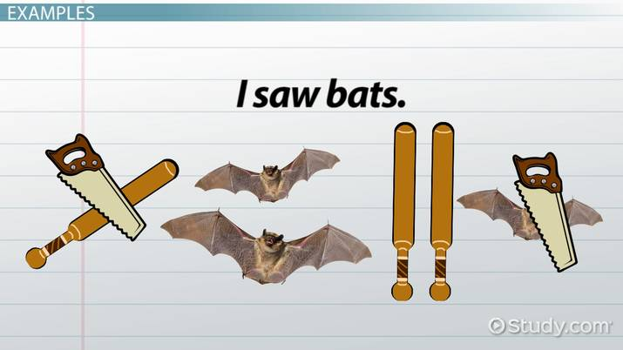
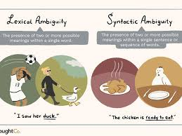
Ambiguity :

Slide 3
Ambiguous means Open to more than one interpretation , Not having one obvious meaning
A grammar is said to ambiguous if for any string generated by it, it produces more than one-
Parse tree Or
Leftmost Derivation Or
Rightmost Derivation
If there exists at least one such string, then the grammar is ambiguous otherwise unambiguous.
Notes:
Ambiguous means Open to more than one interpretation , Not having one obvious meaning

Slide 4
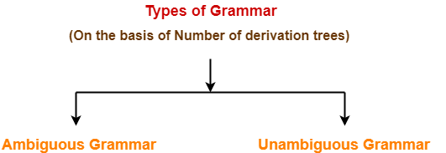
Ambiguous and Unambiguous Grammar :

Slide 5
Grammar Ambiguity-
There exists no general algorithm to remove the ambiguity from grammar.
To check grammar ambiguity, we try finding a string that has more than one parse tree.
If any such string exists, then the grammar is ambiguous otherwise not.

Slide 6
Example 01-
Consider the following grammar-
E → E + E | E x E | id
Ambiguous Grammar
This grammar is an example of ambiguous grammar.
Any of the following reasons can be stated to prove the grammar ambiguous-

Slide 7
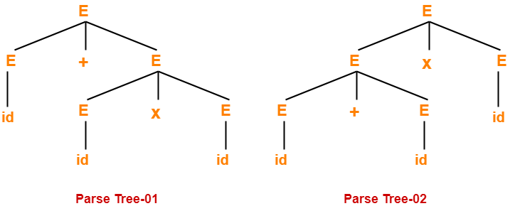
Reason-01: Parse Tree
E → E + E | E x E | id
Let us consider a string w generated by the grammar-
w = id + id x id
Now, let us draw the parse trees for this string w.
Since two parse trees exist for string w, the grammar is ambiguous.

Slide 8
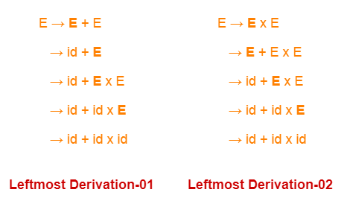
Reason-02: Leftmost Derivation :
E → E + E | E x E | id
Let us consider a string w generated by the grammar-
w = id + id x id
Now, let us write the leftmost derivations for this string w.
Since two leftmost derivations exist for string w, the grammar is ambiguous.

Slide 9
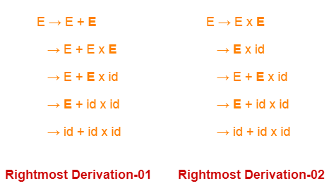
Reason-03 : Rightmost Derivation
E → E + E | E x E | id
Let us consider a string w generated by the grammar-
w = id + id x id
Now, let us write the rightmost derivations for this string w.
Since two rightmost derivations exist for string w, the grammar is ambiguous.

Slide 10
Example -02:
Check whether the given grammar is ambiguous or not-
S → A / B
A → aAb / ab
B → abB / ∈
Solution-
Let us consider a string w generated by the given grammar-
w = ab
Now, let us draw parse trees for this string w.

Slide 11
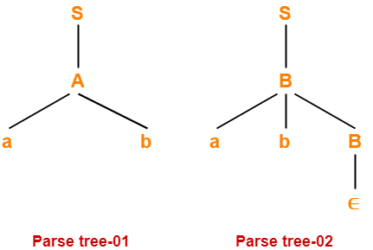
Since two different parse trees exist for string w, the given grammar is ambiguous.

Slide 12
Example - 03:
Check whether the given grammar is ambiguous or not-
S → AB / C
A → aAb / ab
B → cBd / cd
C → aCd / aDd
D → bDc / bc
Solution-
Let us consider a string w generated by the given grammar-
w = aabbccdd
Now, let us draw parse trees for this string w.

Slide 13
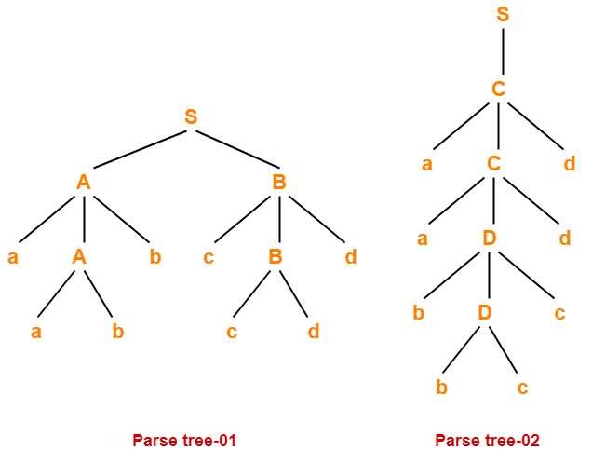
Since two different parse trees exist for string w, the given grammar is ambiguous.

Slide 14
Example - 04:
Check whether the given grammar is ambiguous or not-
S → aSbS / bSaS / ∈
Solution-
Let us consider a string w generated by the given grammar-
w = abab
Now, let us draw parse trees for this string w.

Slide 15
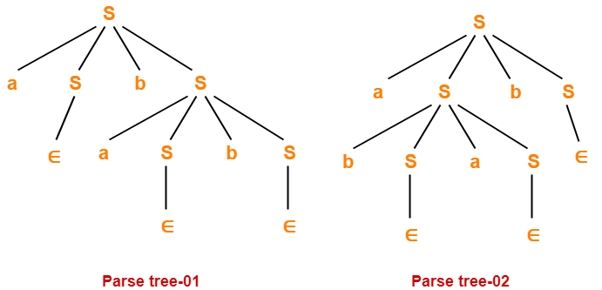
Since two different parse trees exist for string w, the given grammar is ambiguous.

Slide 16
Example -05:
Check whether the given grammar is ambiguous or not-
S → SS
S → a
S → b
Solution-
Let us consider a string w generated by the given grammar-
w = abba
Now, let us draw parse trees for this string w.

Slide 17
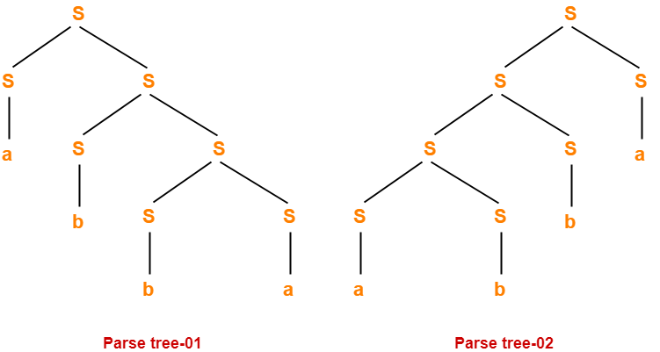
Since two different parse trees exist for string w, therefore the given grammar is ambiguous.

Slide 18
∑ = { a , b }
L = { w € L | w begins with a }
L = { a , aa, ab, aab, aba, aaa, ………}
S -> aA
A -> aA | bA | €
For ‘a’
S
a A
€
Derivation of ‘a’
S →aA
→a

Slide 19
S -> aA A -> aA | bA | €
For generating ‘aa’
S
a A
a A
€
Derivation of ‘aa’
S →aA
→aaA
→aa

Slide 20
S -> aA A -> aA | bA | €
Derivation of ‘aba’
S →aA
→abA
→abaA
→aba
For generating ‘aba’
S
a A
b A
a A
€
This is an example of Unambiguous Grammar
In this grammar, the tuples are :
V = {S, A}
T = { a,b }
P
S = S

Slide 21
Example 6 :
Consider the following example :
S → aB / bA
A → aS / bAA / a
B → bS / aBB / b
Let us consider a string
w = aaabbabbba
Now, let us derive the string w using leftmost derivation.

Slide 22
Leftmost Derivation -
S → aB / bA
A → aS / bAA / a
B → bS / aBB / b
aaabbabbba
S → aB
→ aaBB (Using B → aBB)
→ aaaBBB (Using B → aBB)
→ aaabBB (Using B → b)
→ aaabbB (Using B → b)
→ aaabbaBB (Using B → aBB)
→ aaabbabB (Using B → b)
→ aaabbabbS (Using B → bS)
→ aaabbabbbA (Using S → bA)
→ aaabbabbba (Using A → a)

Slide 23
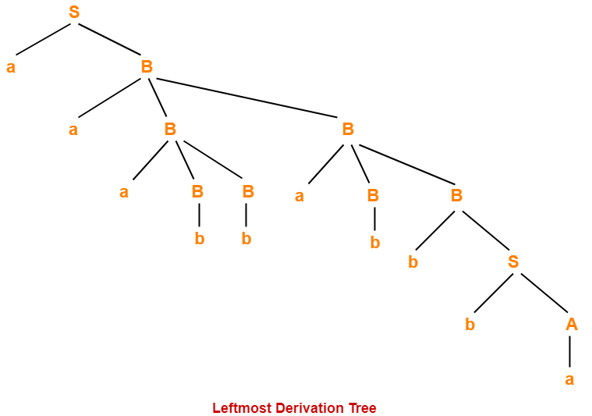

Slide 24
Rightmost Derivation-
S → aB / bA
A → aS / bAA / a
B → bS / aBB / b
aaabbabbba
S → aB
→ aaBB (Using B → aBB)
→ aaBaBB (Using B → aBB)
→ aaBaBbS (Using B → bS)
→ aaBaBbbA (Using S → bA)
→ aaBaBbba (Using A → a)
→ aaBabbba (Using B → b)
→ aaaBBabbba (Using B → aBB)
→ aaaBbabbba (Using B → b)
→ aaabbabbba (Using B → b)

Slide 25
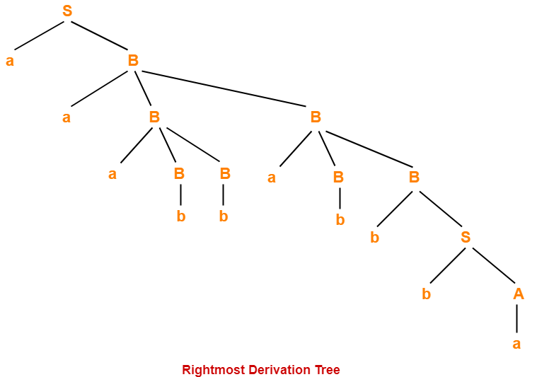

Slide 26
Since one parse tree exists for string w, the given grammar is unambiguous.

